Slide 1
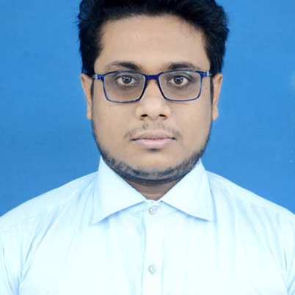

Abhiroop Jana
Analyst/Software Engineer
Bachelor of Technology,
Electronics and Communication Engineering : 2018-2022
I Transform L&D Left shift batch
Bangalore
Skills
abhiroop.jana@capgemini.com
C# | Basics, OOPS, Exception Handling ,Arrays ,Collection and Generics, Collections
.NET Framework | ADO.NET,ASP.NET with MVC5 and WEB API, Entity Framework
Database | SQL SERVER
Tools | GIT,POSTMAN, Swagger
UI Technology | HTML5 ,CSS 3 & Angular
Add On Skills | Communication Skills, Team Management, UI Designing , Microsoft Office. .
+91 8116057806
A4
Full Stack Developer
Understanding of RDMS concepts using SQL Server.
Practical understanding of C# and SQL concepts using Visual Studio and SQL Server
Hands on experience in developing applications using .NET Framework, ASP.NET MVC with WEB API , LINQ , Entity Framework
Understanding of HTML5 , CSS and Angular CLI
Experience in creating documentation with Swagger and Postman
Completed case study on OnDemand Car Wash which is a Web based System where user can easily book a car service from the comfort of his doorstep .This project will be beneficial for those people who don’t want to go to the garage. It is an easy and time saving System. This online system provides home delivery of car wash service for that users have needs to register in this System. Then the user can choose the services available can also set the date and location of the service . Accordingly a washer will come to his location and will provide the service.
Technologies used:
ANGULAR
ASP.NET CORE
Microsoft SQL Server
Video Link : Click
GitHub Link

